Slide 1
Pose Byte Template
One sentence summary.

Slide 2
The Bits
Each bit is in the form of a short blog post with an accompanying narrated video - about 15 minutes each:
Attention: the Origin of Pose.
Mathematics of Pose.
Engineering Pose Representations.
What Geo Adds to Pose.
Perception, and the Automation of Pose Discovery.
Semantic Focus: Shrinking the Search Space.
Artificial Perception: Architectures and APIs.
Standardized GeoPose and Its Components.

Slide 3
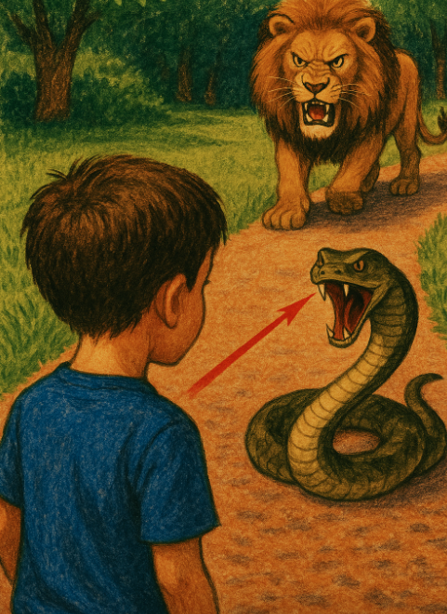
Ten to Fifteen Slides to Tell the Story
Text goes here

Slide 4
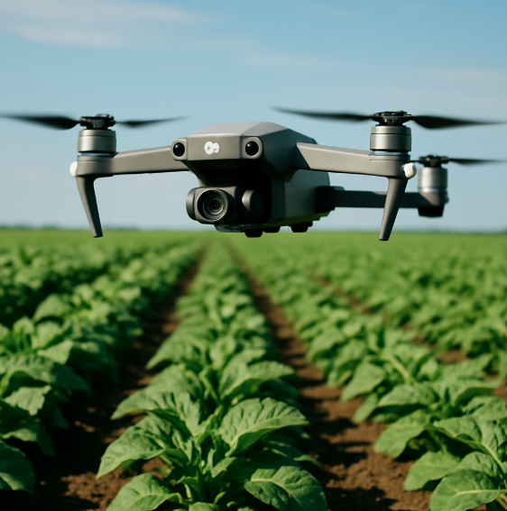
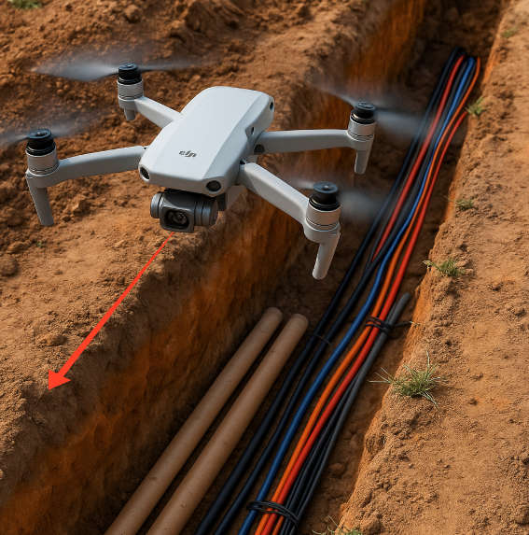



Using <Topic>
Explain why it is useful and/or money making,

Slide 5
Wrapup
Tell them what you’ve told them.

Slide 6
References: Overview
Lima & Dill (1990). Classic review of decisions under predation risk; frames the vigilance–foraging trade-off. gambusia.zo.ncsu.edu
Lima & Bednekoff (1999/2009). Risk Allocation Hypothesis and later reassessment; when prey should shift attention across fluctuating danger. CellScienceDirectjstor.org
Laundré et al. (2010); Palmer et al. (2019); Gaynor et al. (2017). “Landscape of fear” concept and updates—spatial patterns of perceived risk shaping posture/vigilance and space use. predatordefense.orgScienceDirectpeerj.com
Brown (1988). “Giving-up densities” (GUD): patch-leaving as a readout of foraging vs. fear costs. SpringerLink
Stephens & Krebs (1986). Foraging Theory (monograph) — core models behind attention to food vs. danger. books.google.com
Brown & Kotler (2004). “Hazardous duty pay” review—quantifying the foraging cost of predation. Wiley Online Library
Kotler et al. (2006). Meta-analysis using GUDs to measure fear–foraging trade-offs. SpringerLink

Slide 7
References: <Subtopics>
Lima & Dill (1990). Classic review of decisions under predation risk; frames the vigilance–foraging trade-off. gambusia.zo.ncsu.edu
Lima & Bednekoff (1999/2009). Risk Allocation Hypothesis and later reassessment; when prey should shift attention across fluctuating danger. CellScienceDirectjstor.org
Laundré et al. (2010); Palmer et al. (2019); Gaynor et al. (2017). “Landscape of fear” concept and updates—spatial patterns of perceived risk shaping posture/vigilance and space use. predatordefense.orgScienceDirectpeerj.com
Brown (1988). “Giving-up densities” (GUD): patch-leaving as a readout of foraging vs. fear costs. SpringerLink
Stephens & Krebs (1986). Foraging Theory (monograph) — core models behind attention to food vs. danger. books.google.com
Brown & Kotler (2004). “Hazardous duty pay” review—quantifying the foraging cost of predation. Wiley Online Library
Kotler et al. (2006). Meta-analysis using GUDs to measure fear–foraging trade-offs. SpringerLink

Slide 8
References: OGC GeoPose 1.0
The OGC GeoPose 1.0 Data Exchange Standard is an OGC Implementation Standard, approved on June 20, 2022, and published on September 8, 2023 geopose.org+14docs.ogc.org+14medium.com+14.
It is designated as OGC Doc No. 21-056r11 docs.ogc.org+2ogc.org+2.
The standard defines an interoperable way to express and exchange the location and orientation (poses) of real or virtual geometric objects in geographic reference frames (Earth or astronomical coordinate systems) github.com+13ogc.org+13ogc.org+13.

